Slide 1

HTML Tag Syntax Checker Using Stack ADT CSA0301-Data Structures
Guided by
Dr. VIGNESH JANARTHANAN J
Presented by
Steffi I (192524480)

Slide 2


ABSTRACT
HTML documents must have properly matched opening and closing tags.
A syntax checker ensures correctness of tag structure.
This project uses an Abstract Data Type (ADT) to validate HTML tags.
The Stack ADT is most suitable for this problem.
It improves efficiency and accuracy in detecting errors.

Slide 3
INTRODUCTION
HTML uses tags like <html>, <body>, <p> etc.
Each opening tag must have a corresponding closing tag.
Incorrect nesting leads to webpage errors.
Syntax checking is important for web development.
Data structures help automate this validation process.

Slide 4
PROBLEM STATEMENT
Given an HTML file, check whether all tags are properly matched.
Detect missing, extra, or wrongly nested tags.
Ensure correct opening and closing order.
Provide error indication if mismatch occurs.
Handle multiple nested tags efficiently.

Slide 5
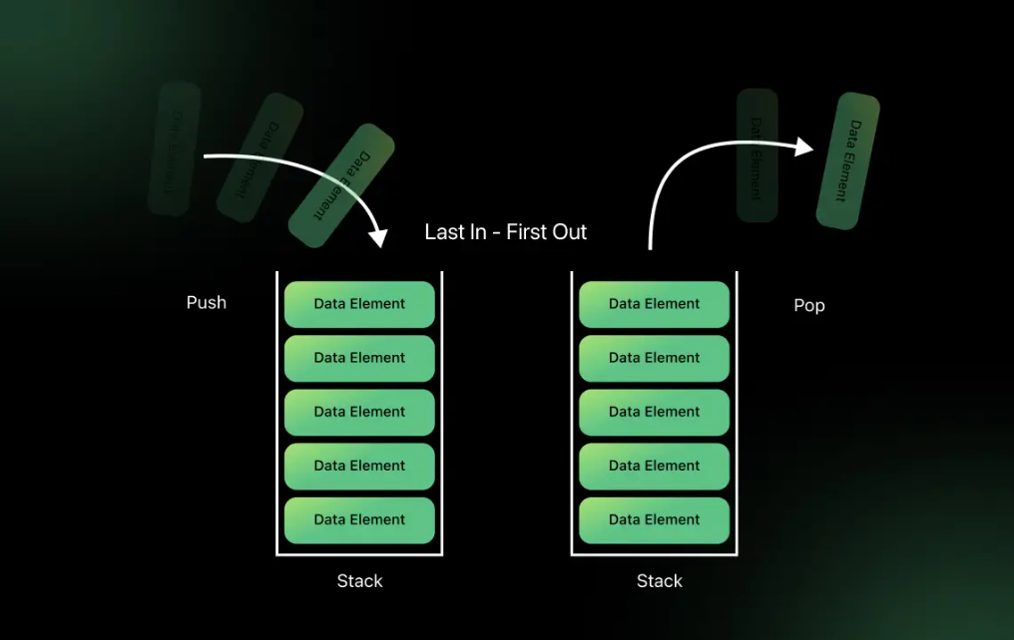
PROPOSED SOLUTION
Use a Stack (LIFO – Last In First Out).
Push all opening tags into the stack.
When a closing tag appears, pop from stack.
Compare popped tag with closing tag.
If mismatch or stack is empty → error.
If stack is empty at end → valid HTML.

Slide 6
RESULTS
Correctly identifies matched HTML tags.
Detects missing or extra tags easily.
Works efficiently for nested structures.
Time complexity is O(n) (linear scan).
Provides reliable syntax validation.

Slide 7
Conclusion
Stack ADT is ideal for syntax checking problems.
It handles nested structures naturally.
Ensures efficient and simple implementation.
Reduces manual checking errors.
Widely used in compilers and web validators.

Slide 8


